Slide 1
Yoga nidra
Renee Gongora, Ed.S., M.Ed., 200 hr
Satya Space with Renee
Akasha Yoga Studio of Corpus Christi
With Leah Murray, YTT Autumn 2023

Slide 2
Agenda
HISTORY OF YOGA NIDRA
8 STEPS OF YOGA NIDRA
BENEFITS OF YOGA NIDRA
CONTRAINDICATIONS, CONSIDERATIONS, & MYTHS

Slide 3
What is yoga nidra?
Origin and history

Slide 4
WHAT IS YOGA NIDRA?
The origins of Yoga Nidra can be traced to various ancient Eastern spiritual teachings including, for example, Vedanta in such texts as the Mandukya and Taittiriya Upanishads, and the teachings of Yoga in texts such as Yogataravali and the Yoga Sutras of Patanjali.
www.irest.org>yoga-nidra-and-irest
This Photo by Unknown Author is licensed under CC BY-SA-NC

Slide 5
WHAT IS YOGA NIDRA?
Swami Satyananda Saraswati developed this system of relaxation in the mid 20th century, after studying and practicing the tantric scriptures. His explanation of Yoga nidra was as a state of mind between wakefulness and dream, wherein deep constructs of the mind become opened.
Where and when did the origin of Yoga Nidra begin? Within the Mahabharata – Book 1: Adi Parva/Section XXI, it is stated: “It becomes the bed of the lotus-naveled Vishnu when at the termination of every Yuga that deity of immeasurable power enjoys yoga-nidra, the deep sleep under the spell of spiritual meditation.” The point is Yoga Nidra has been around for many centuries. It is safe to say the text was compiled around 300 BCE, give or take a few centuries, and this knowledge existed in verbal format before it was put down in writing.
https://aurawellnesscenter.com/
This Photo by Unknown Author is licensed under CC BY

Slide 6
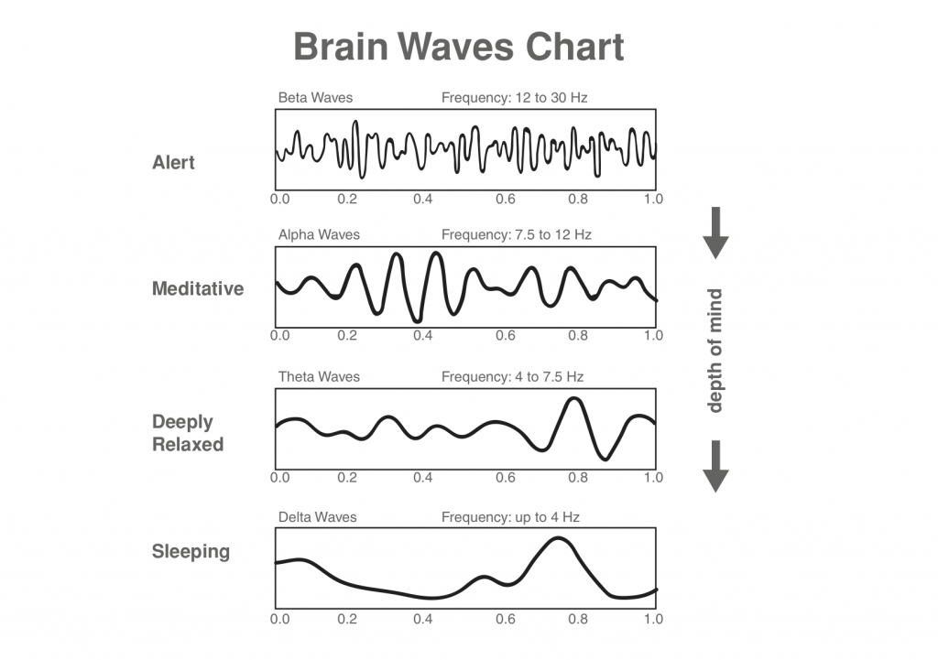
WHAT IS YOGA NIDRA?
Switches the nervous system from sympathetic (fight/flight) to parasympathetic (rest & restore) Shifts brainwave activity from beta to an alpha state Floating space between awake and asleep, with awareness “What is the theory behind yoga nidra? The most general description of the practice is that it combines guided mental imagery with a specific yoga posture called Shavasana (or “corpse pose”). The goal of yoga nidra is to promote a profound state of relaxation, which differs from sleep inasmuchas there is still an awareness of one's surroundings.” https://www.ncbi.nlm.nih.gov/pmc/articles/PMC9033521/#:~:text=The%20most%20general%20description%20of,an%20awareness%20of%20one's%20surroundings.
This Photo by Unknown Author is licensed under CC BY-SA

Slide 7
Steps of yoga nidra
8 stages

Slide 8
8 stages of nidra
1. Setting up rest nest
2. connect to your heartfelt desire and set your Sankalpa
a.k.a. intention or resolve
5. feelings and opposites sensations (heat/cold, pain/pleasure, joy/sorrow, love/hate
7. ending the practice (with the sankalpa from beginning)
3. rotation of consciousness through your body (start on the right side)
4. breath awareness
6. visualizations - universal significance (landscapes, oceans, mountains, temples, saints, flowers, stories, chakras, golden egg).The last image evokes profound feeling of peace and calmness. This make the unconscious mind very receptive to positive thoughts and suggestions.
8. return mind from psychic sleep to waking state
source: Yoga Nidra by Swami Satyananda Saraswati, Yoga Plublications Trust, Reprinted 2008, pages 69-73

Slide 9
8 process of pratyahara (stages of raja yoga)
1. Yamas (social code)
2. Niyamas (personal code)
5. Pratyahara (withdrawal of senses)
7. Dhyana (meditation)
3. Asanas
(poses- states of being)
4. Pranayama (control of prana, life-force, cosmic energy)
6. Dharana (concentrations)
8. Samadhi (transcendental consciousness)
source: Yoga Nidra by Swami Satyananda Saraswati, Yoga Plublications Trust, Reprinted 2008, pages 28

Slide 10
Benefits of yoga nidra

Slide 11
Benefits (not inclusive, subjective)
rest and relaxation, helps reduce insomnia, improves sleep cycles
The practice of yogic sleep gives the body time to rest, recover and restore. The result? Less inflammation and improved functioning of the immune system.
can be practiced by almost anyone, from child to senior citizen
spiritual and emotional dimension using a sankalpa for well-being
helps with anxiety and depression, ADD/ADHD, and PTSD/PTSS
relieves stress and tension and reducing pain, reduces inflammation
1 hour nidra = 4 hours restful sleep
30 min nidra = 2 hours restful sleep
enhancing cognition and memory : There are two factors involved in the process of memory. The first is the brain’s ability to absorb information, and the second is its ability to recall that information. Yoga Nidra works on both of these levels by establishing a state of maximum receptivity in the subconscious mind, along with a simultaneous state of awareness.
Source: yoga nidra - www.lucia.ie
https://yogauonline.com/yoga-health-benefits/yoga-for-stress-relief/7-amazing-benefits-of-yoga-nidra/
Pregnancy
Different languages
Deaf and differently-abled

Slide 12
Contraindications, considerations, & myths of yoga nidra

Slide 13
Contraindications and Myths
Contraindications & Considerations
Myths
People suffering or diagnosed with severe depression, severe trauma, and severe mental health conditions (seek prior medical professional consultations)
Consider scripts and participants (example: water imagery with a person who has a fear of water or traumatic experience with water)
Considerations of Rotation of consciousness
(be careful of squeezing fists with a person who had physical abuse)
Restless leg syndrome
Snoring during sessions – what do you do
Nidra isn’t backed by science. (There are many research studies proving it’s validity.)
It is always relaxing and fast fix.
Nidra is NOT hypnosis. In fact, it is the opposite direction.
Nidra does NOT replace sleep.
Quality sleep is extremely necessary for mental and physical well-being, cellular restoration and repair, skin care and living a wholesome life.
www.kaminidesai.com

Slide 14
Summary
Nidra scripts and sessions are available online through websites and YouTube videos.
There is a synergy of practicing nidra in person in class to benefit the collective consciousness.
Questions, criticisms, compliments, or concerns?

Slide 15
Thank you namaste
Renee Gongora
satyaspacewithrenee@gmail.com
Satyaspacewithrenee.com

